Slide 1
Security Modernizing Concepts
AWS Modernization Team

Slide 2

Did you pack your own bag?
Did you build your own container images?
How intimately do you know the contents?
Can you trust where they came from?

Slide 3
Container image risks:
Do your containers contain undesirable config?
Do your containers or dependencies contain vulnerabilities?
Container images rafted by internal teams or provided by a trusted source can manifest risks over time.

Slide 4

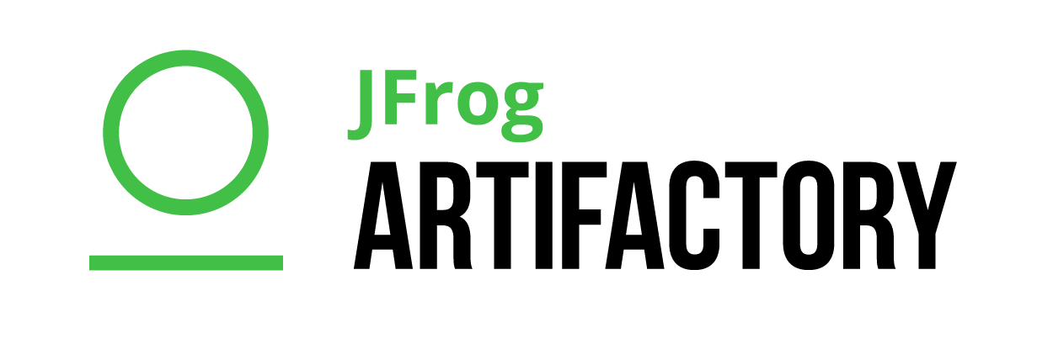


Build your own trusted source:
Source container image repos
Scan container images for vulnerabilities.
Scan previously white listed objects for new risks.
Store white listed artifacts for reuse.
Amazon ECR
Import images to
Assessment repo
Devs build applications using trusted objects.

Slide 5
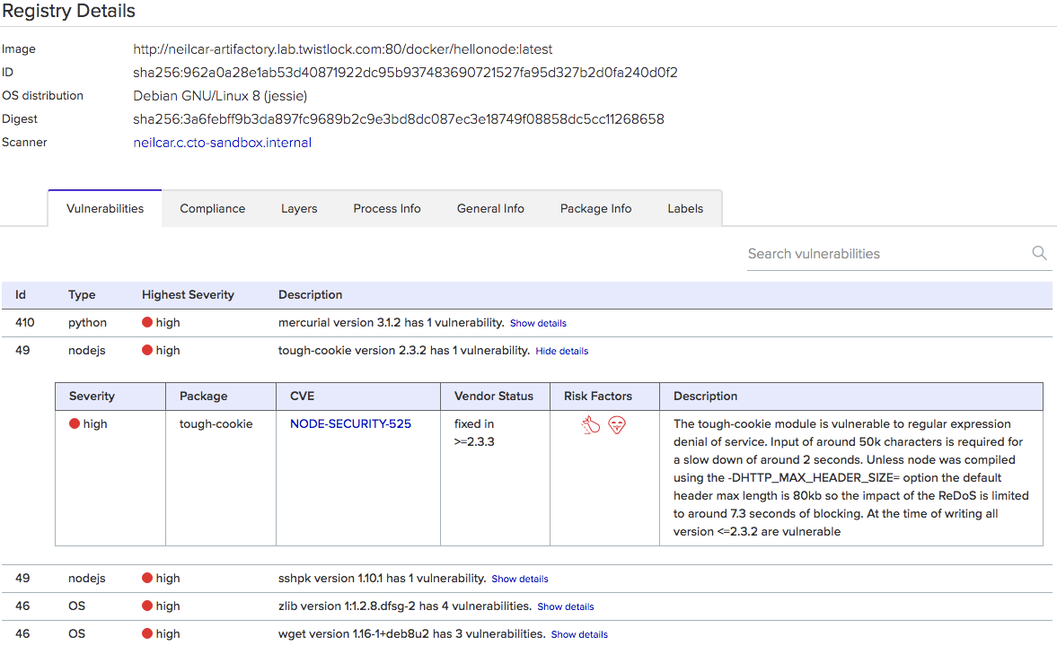

Slide 6
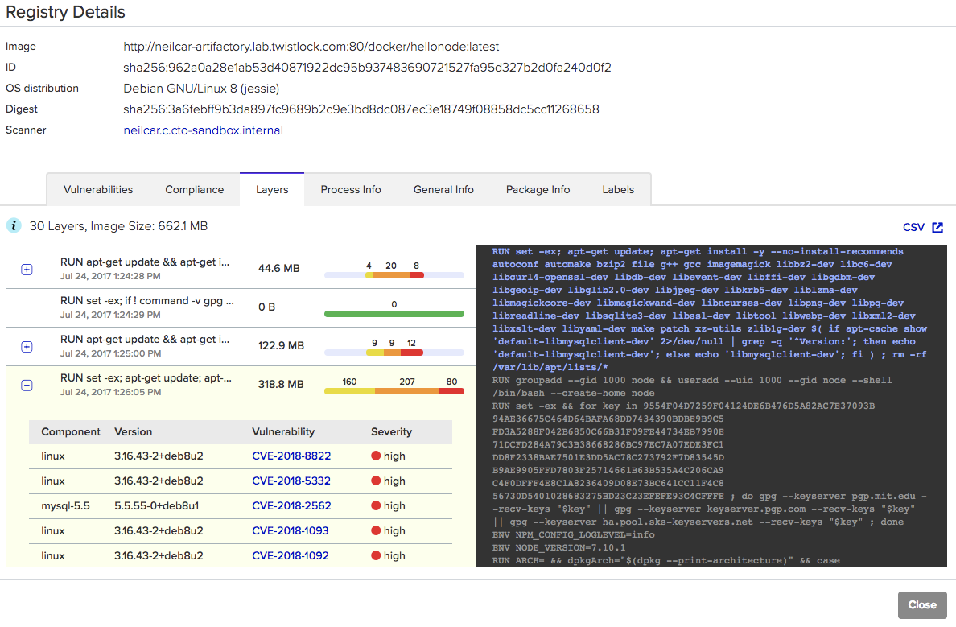

Slide 7
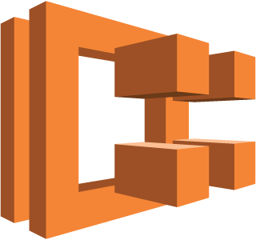



I checked it before, so it should be safe…
Security should be continuous.
Scan what is in production for new risks or post deployment deviations.
Amazon ECS
Amazon Inspector
Continuously assess running workloads
Amazon EC2
Agent and API data
AWS Config
Continuously assess state and configuration

Slide 8
Modern Security Tenets:
Agile
Automated
Continuous
Collaborative
Rails not gates
Photo & Licence
Notes:
Traditional Security models focus on security review post Dev and test process, these are often manual and time consuming, starting too late in the dev process.
As development and operational workloads become more and more agile like wise Security should evolve to match.
Integrating the Security process into CICD and automation solutions can greatly increase agility, allowing DEV SEC Ops teams to start the security assessment sooner.
Security assessment responding to commits and pull requests in the Source Code Management systems allows for smaller more frequent security assessment, detecting issues sooner and allowing these to be addressed in a more incremental fashion.
Integration with CICD solutions reduced human administrative bottle necks in the process. Any aspect that can be automated should.
Dev and Ops teams should be key stake holders in the security process, defining what and how security goals should be achieved. Making these code owner the owner of security as well builds a tighter investment in making sure that security goals are met. Focus should shift away from building code to releasing code.
No tool in isolation will cater for this, organization and mind set change will be an essential part of this.
Security should focus on building best practice, all parties should understand the risks and why they need to be addressed and how to work together to prevent these.
Security should be prescriptive,
The process should allow dev teams to be guided towards building for security from the start not being blocked and pushed back.

